Slide 1
2016 Vegetable Weed Control
Mechanical
Cultural
Herbicide/
Fumigant
DIVERSIFICATION

Slide 2
Focus Points
Weed Seed Production
Tillage-Stale Seedbed
Avoiding Herbicide Injury
Specific Crop Programs

Slide 3
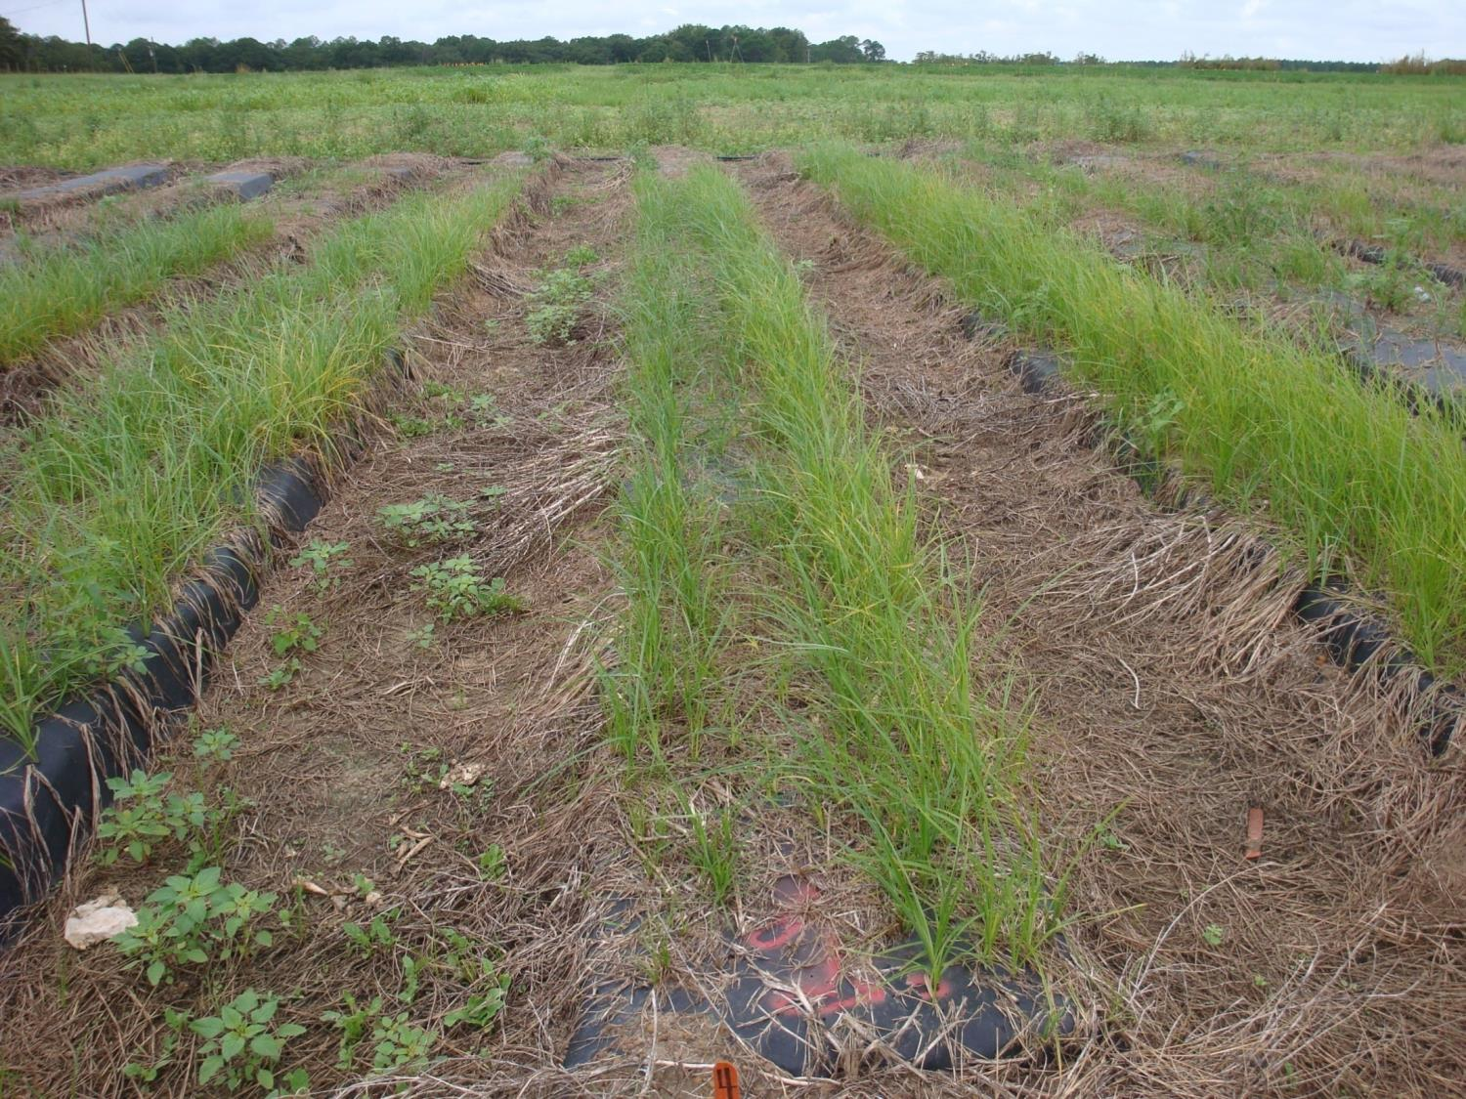
About 3 wk after emergence = tubers

Slide 4
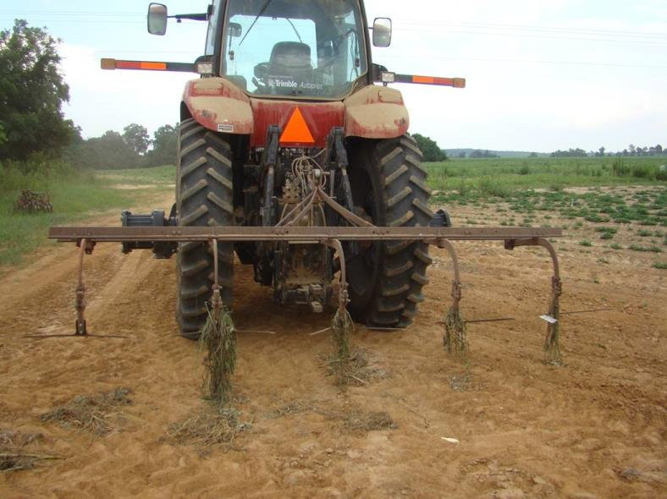
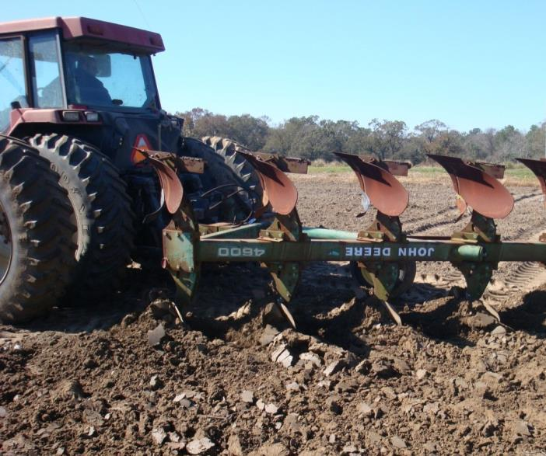
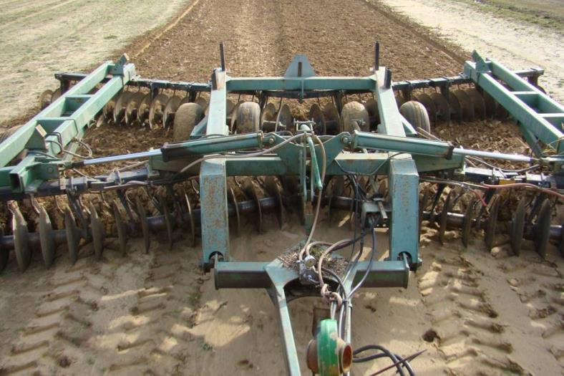
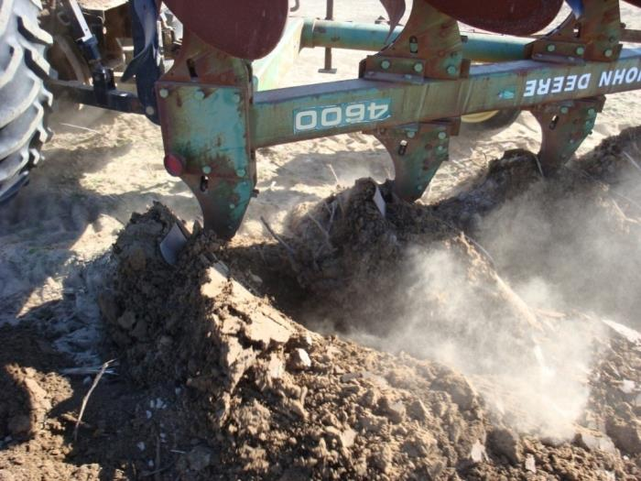
Tillage can be helpful……or harmful.

Slide 5

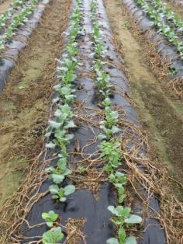
Tillage can be helpful……Stale Seedbed.
Stimulation of weed seed germination can be helpful in a stale seedbed approach in crops challenged with weeds.
At times, at least half your weeds will emerge in the first 7-10 days after a tillage.
Prepare bed for planting, spray with Roundup or Gramoxone or both prior to planting.
Double Knock:
Spray Roundup fb Gramoxone 5-7 days later.

Slide 6
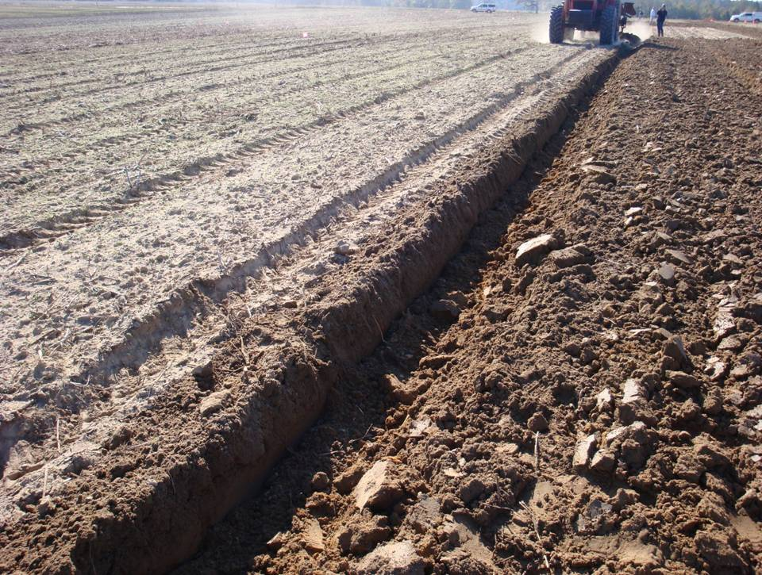

Slide 7
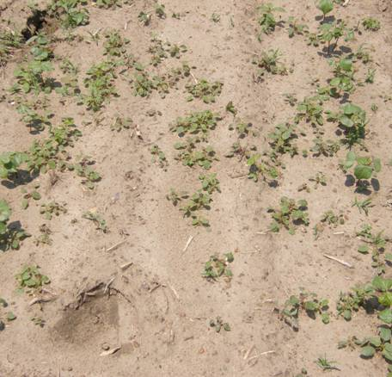
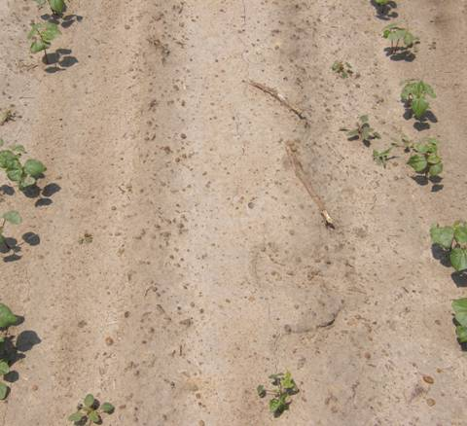
Number of Palmer Amaranth Plants During Early Season. Macon Co., Georgia 2008.*
No Deep Tillage
Deep Turn
No Herbicide Treatment

Slide 8

Tillage can be helpful……Plowing.
Plowing emerged weeds is an effective tool.
Plowing up residual herbicide….not so much.
If plowing, apply residual herbicide after plowing if possible.

Slide 9
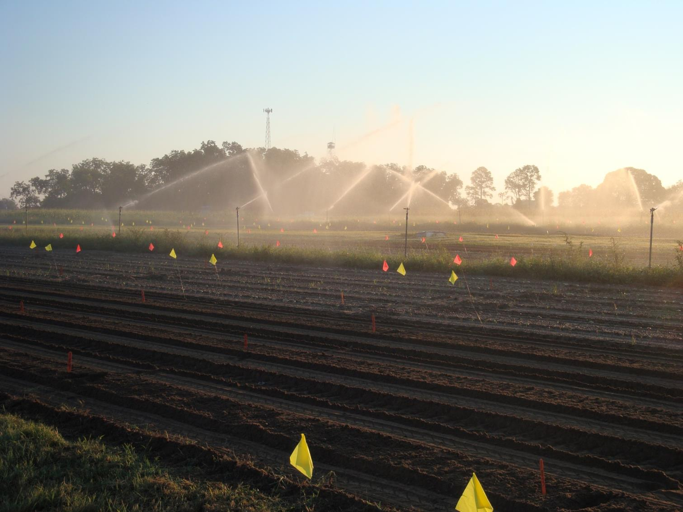
Avoiding Herbicide Injury
Greatly influenced by excess moisture, cold, and incorrect spray calibration.

Slide 10
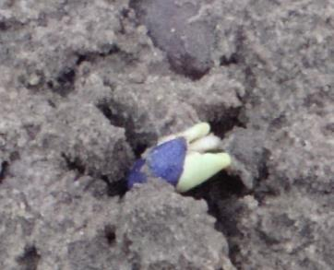
Seed needs to imbibe water free of herbicides
Herbicide
Crop seeds

Slide 11
Seed needs to imbibe water free of herbicides
Herbicide
Crop seeds
Factors Reducing Injury
High vigor seed
Ideal plant depth
Right rate
Plant into moist soil
Smart irrigation

Slide 12
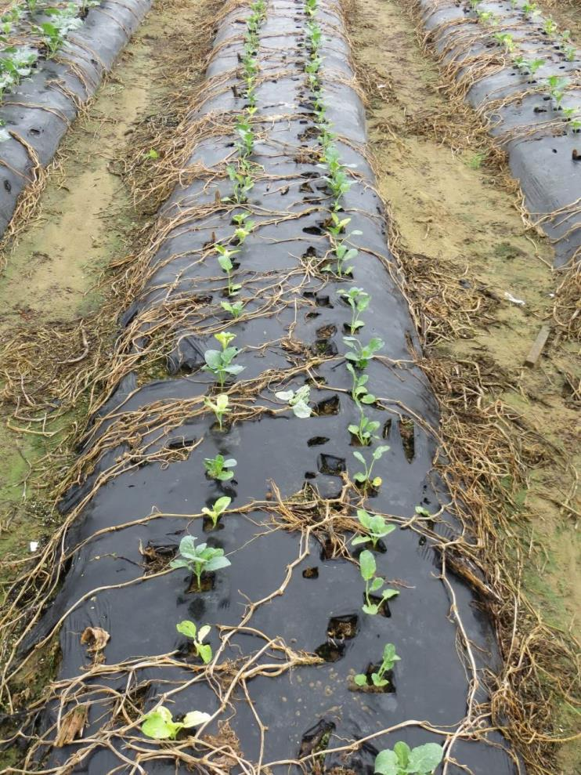

Roundup Preplant
No Roundup

Slide 13
Sandea Dissipation on Mulch
65%
6%
Work by Tim Grey

Slide 14
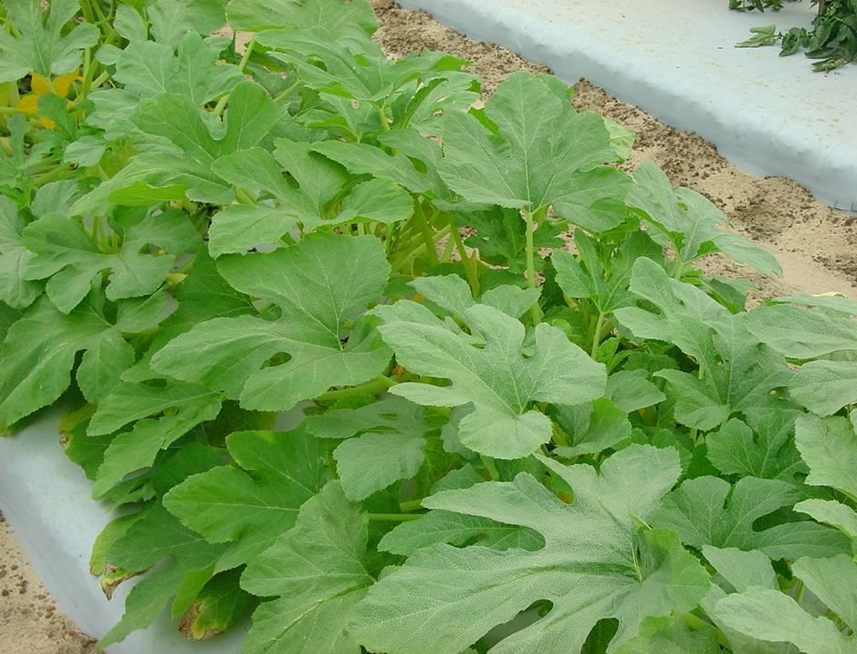
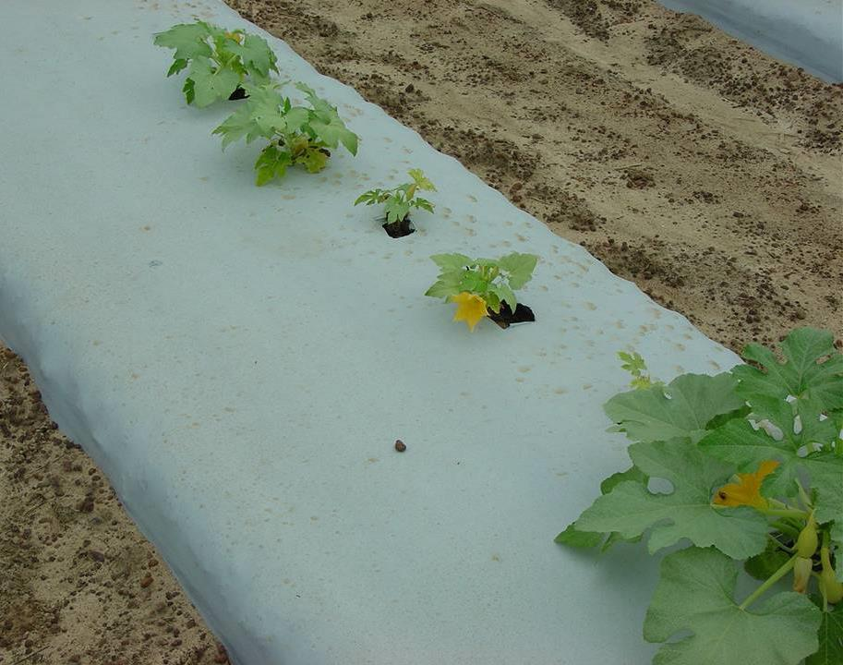
Non-treated
Sandea prior to transplant

Slide 15
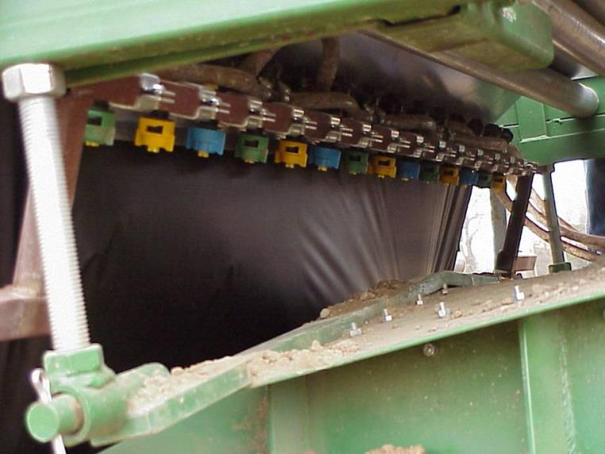
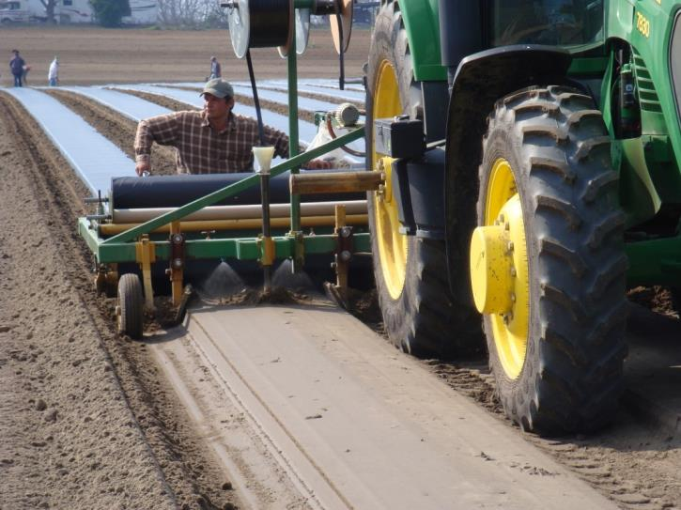
Herbicide Preplant Application Procedure in Plasticulture is Critical

Slide 16

Lima, Snap, Southern Pea
Start Clean: Tillage/Roundup/Gramoxon
Treflan/Prowl preplant incorporated
Herbicide
Crop seeds

Slide 17
Lima, Snap, Southern Pea
(BASE PROGRAM)
Start Clean: Tillage/Roundup/Gramoxone
Treflan/Prowl preplant incorporated
Dual Magnum preemergence
Grass herbicide as needed POST
Dual Magnum directed while cultivating

Slide 18
Snap Bean
Reflex PRE
Reflex POST
Sandea PRE
Sandea POST
Basagran
Pursuit PRE
Lima
Sandea PRE
Sandea POST
Basagran
Pursuit PRE
South. Pea
Basagran
Pursuit PRE
Pursuit POST

Slide 19
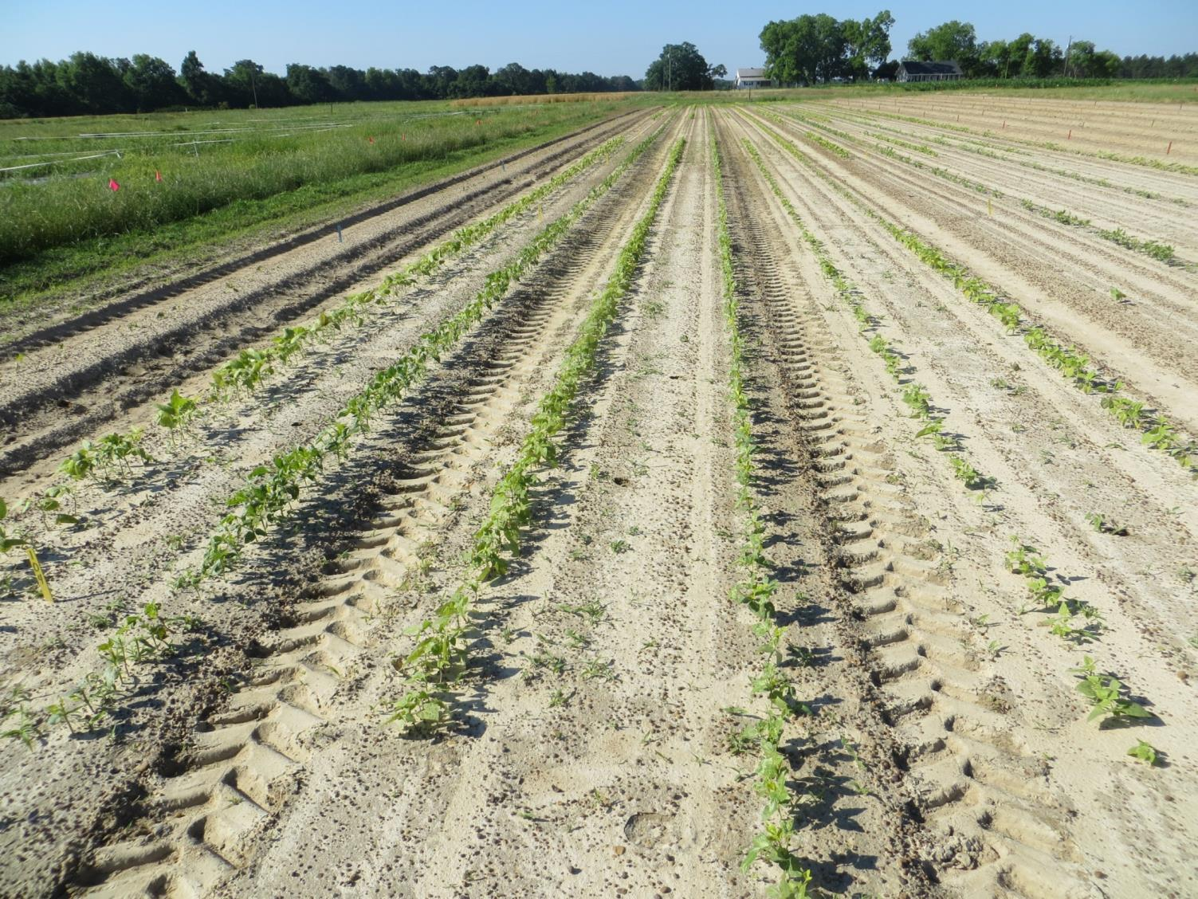
Lima, Snap, Lima, Cowpea, Lima, Cowpea

Slide 20
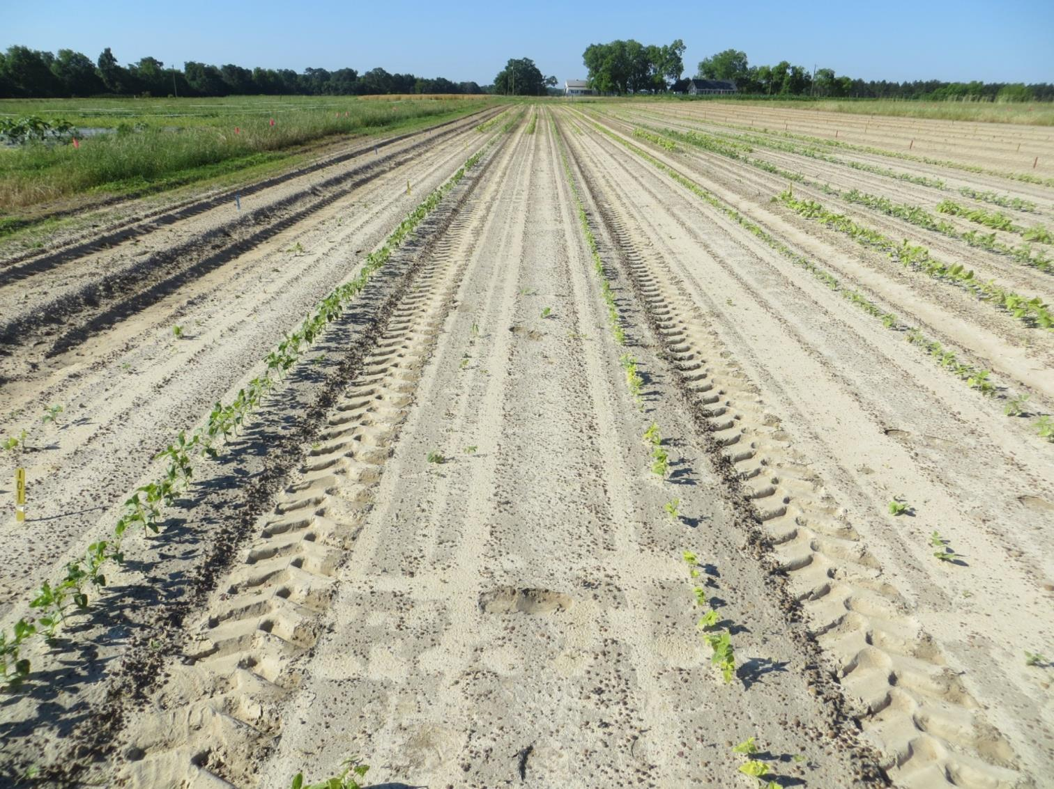
Lima, Snap, Lima, Cowpea, Lima, Cowpea
Reflex 8 oz/A + Dual Magnum 12 oz/A

Slide 21
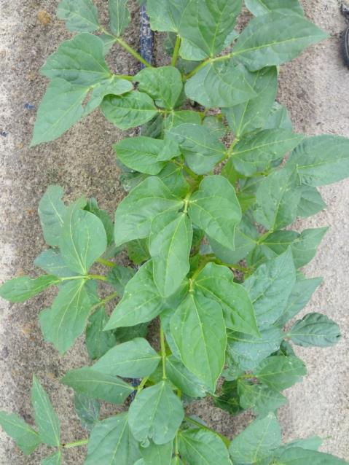
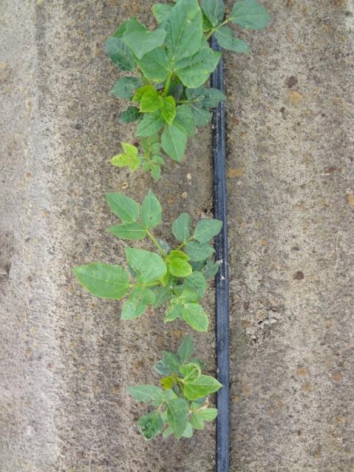
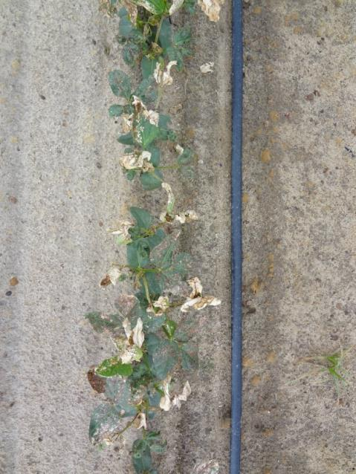
Southern Pea
Treflan
PPI
Treflan + Reflex
PPI
Reflex + NIS
POST
Reflex at 1 pt/A

Slide 22
Cabbage, Broccoli, and Cauliflower (transplants)
Bareground (most aggressive):
1. Incorporate Treflan and prepare beds
2. Apply Goal (add gramoxone if weeds up)
3. Lightly irrigate; wait 3 days with 1 sunny day
4. Transplant
5. Irrigate before applying Dual Mag.
6. Apply 10-12 oz of Dual Mag. topically 7-10 DAP.
7. Grass herbicide as needed.
Cultivation kills the herbicide program!!!!!!!!!!!!!!!

Slide 23
Collard (transplants)
Bareground (most aggressive):
1. Incorporate Treflan and prepare beds
2. Apply Goal (add gramoxone if weeds up)
3. Lightly irrigate; wait 1 to 2 sunny days
4. Transplant
5. Irrigate before applying Dual Mag.
6. Apply 10-12 oz of Dual Mag. topically 7-10 DAP.
7. Grass herbicide as needed.
Cultivation kills the herbicide program!!!!!!!!!!!!!!!

Slide 24
Cabbage, Broccoli, Cauliflower, Collards (seeded)
1. Incorporate Treflan
2. Seed
3. Spray 12 oz of Dual Magnum topically when 3”.
4. Grass herbicide as needed.
Cultivation kills the herbicide program!!!!!!!!!!!!!!!

Slide 25
Turnips and Mustard
(seeded)
1. Incorporate Treflan
2. Seed
3. Grass herbicide as needed.
Cultivation kills the herbicide program!!!!!!!!!!!!!!!

Slide 26
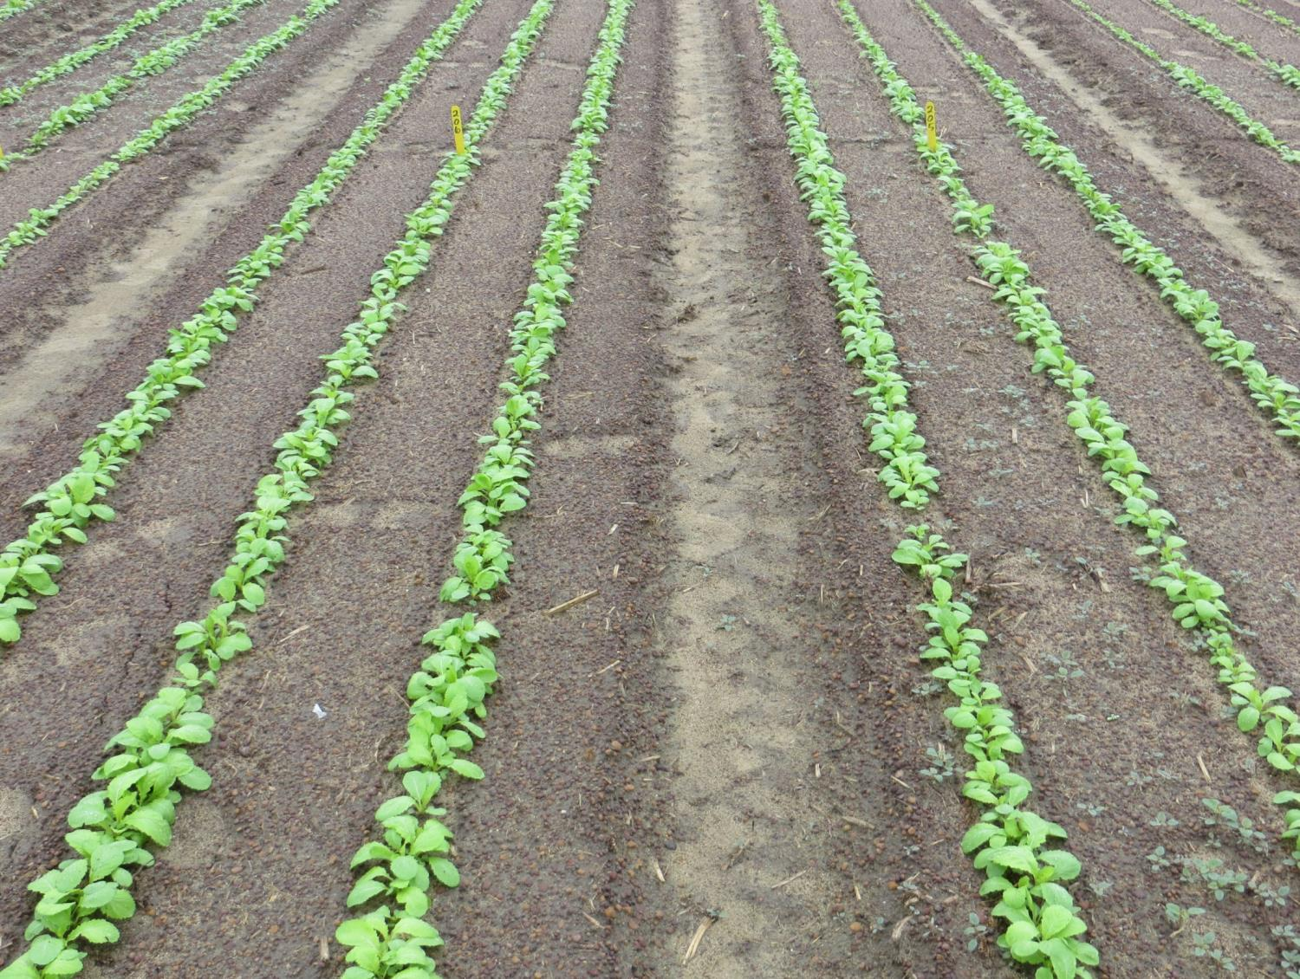
Grower Standard + Future Product?
Grower Standard (not a check!!)
Notice pigweed

Slide 27

Fruiting Vegetables On Mulch
Herbicides under mulch generally don’t perform well and can be problematic (injury, carryover, etc.)

Slide 28
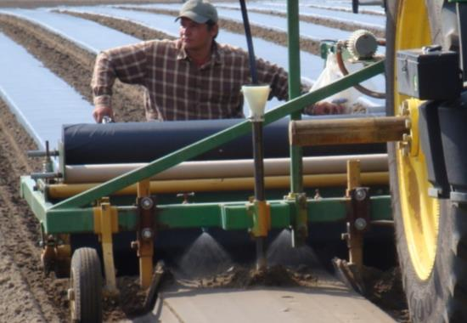
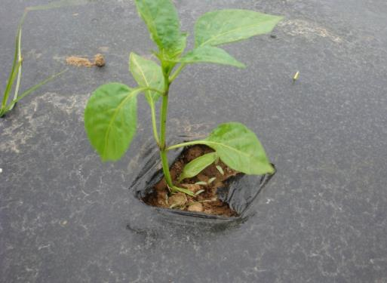
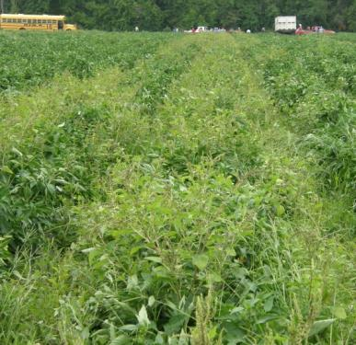
BELL PEPPER HERBICIDE PROGRAM
Preplant under mulch
Topical 7-10 d after transplant
Topical as needed
1.Devrinol
2.Devrinol + Command
3.Devrinol + Reflex
(Dual is labeled but can cause
Stunting)
Dual Magnum 10-12 oz/A
Select Max
TapOut
No adjuvant needed

Slide 29

REFLEX IN TOMATO/PEPPER
EXCELLENT CROP TOLERANCE; 50-70% yellow nutsedge under mulch control, excellent Pigweed control
LABELED

Slide 30
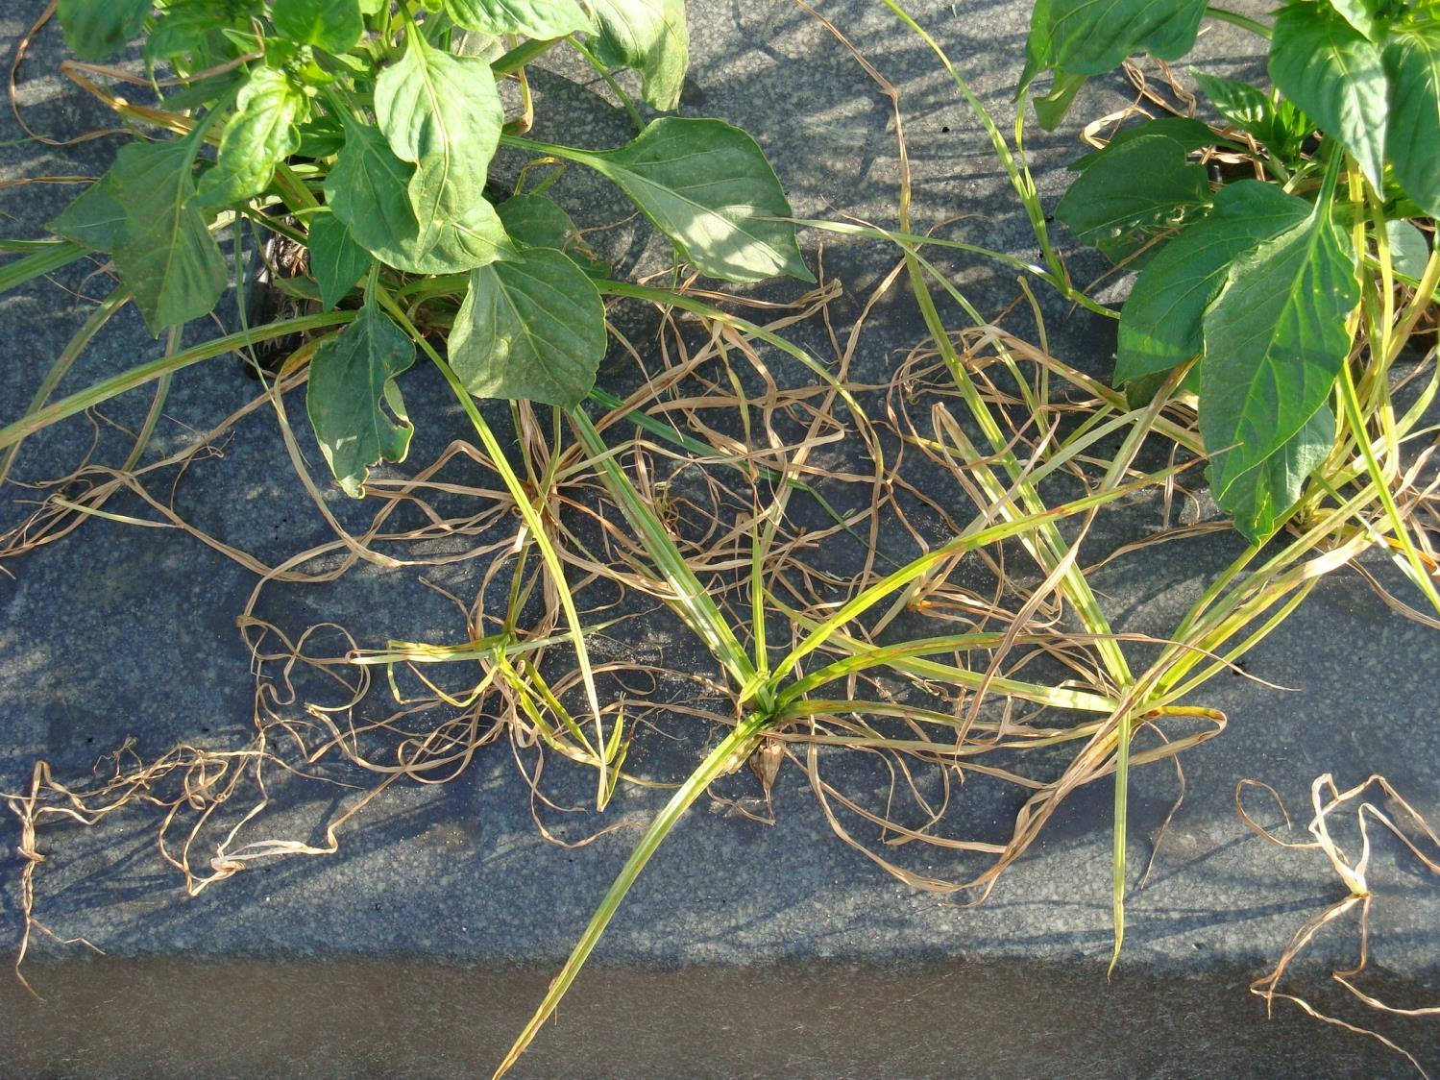
REFLEX PREPLANT ON YELLOW NUTSEDGE

Slide 31
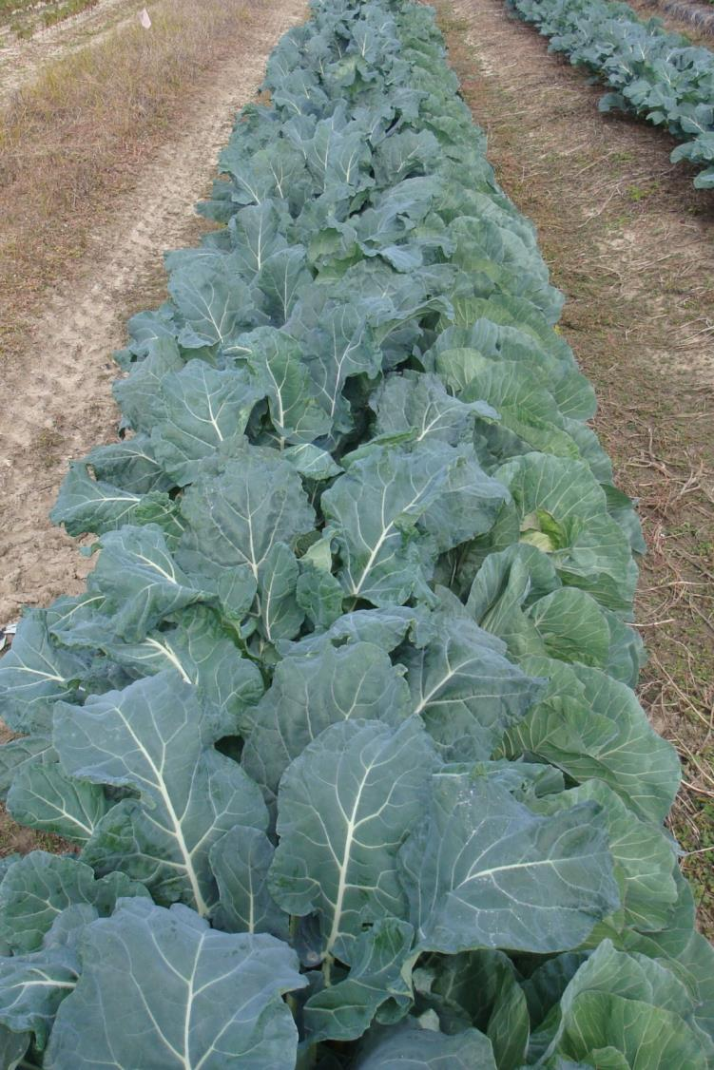
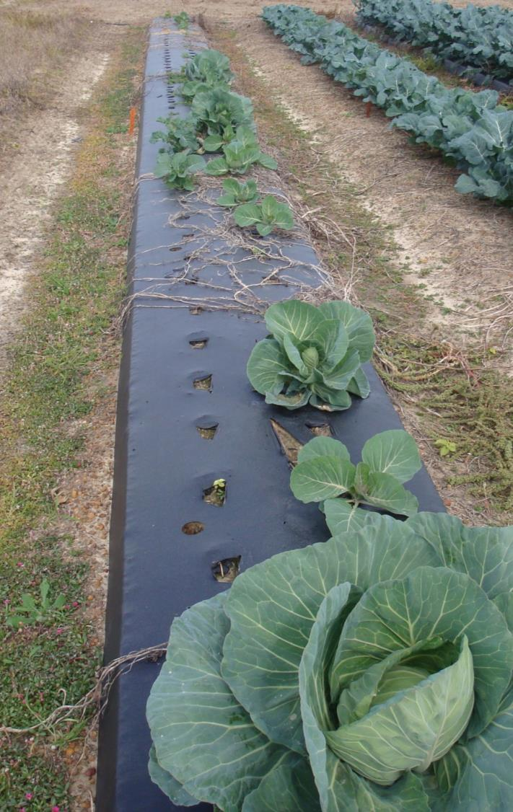
No Reflex
Reflex 1 pt/A applied 205 days before transplanting

Slide 32
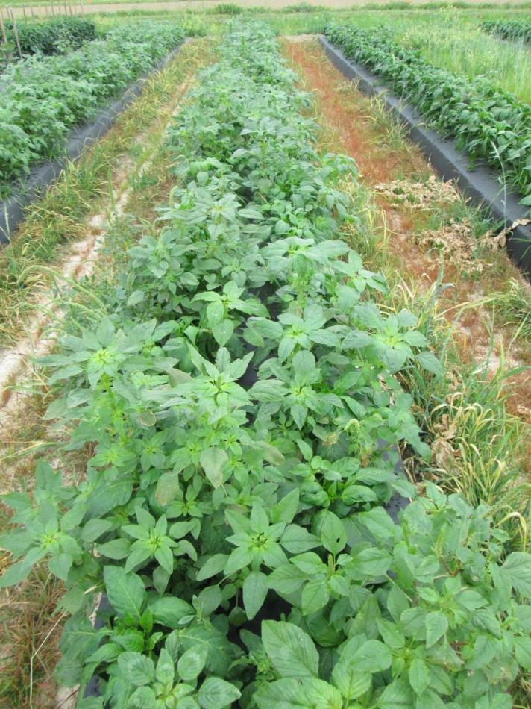
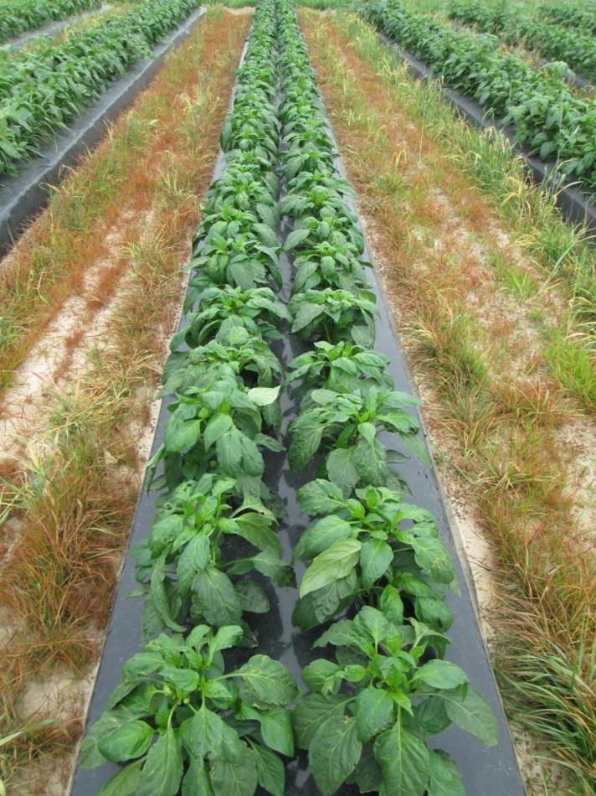
Palmer Amaranth Control With Pic Chlor 60. Tift Co., 2013.
No Herbicide
Plus Dual Mag 12 oz/A

Slide 33
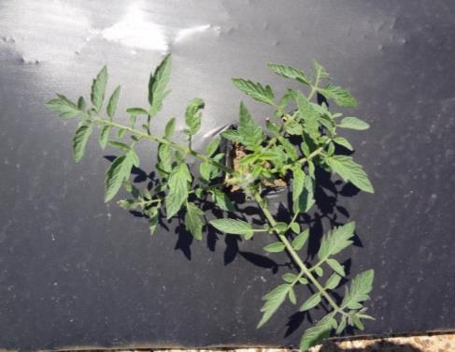
TOMATO HERBICIDE PROGRAM
Preplant under mulch
Topical 10-14 d after transplant; pre-bloom
Topical as needed
1.Devrinol + Dual Mag.
2.Devrinol + metribuzin
3.Devrinol + Reflex
Sandea 0.75 oz
Dual Magnum
1. Select Max
No adjuvant needed

Slide 34
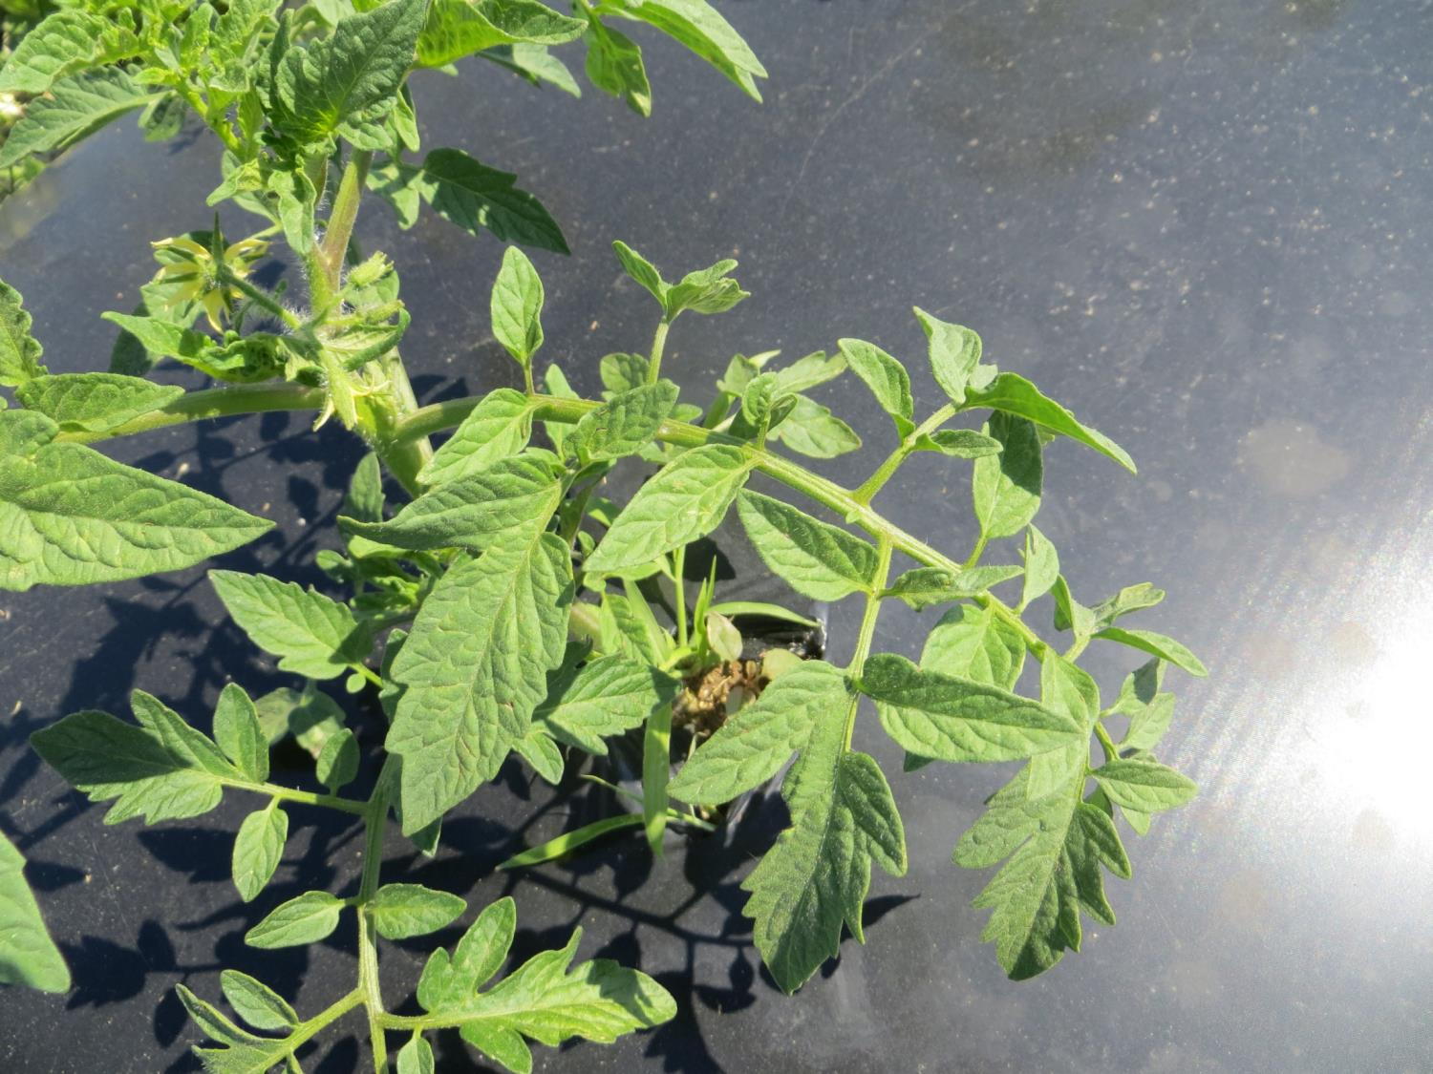
No Dual Magnum

Slide 35
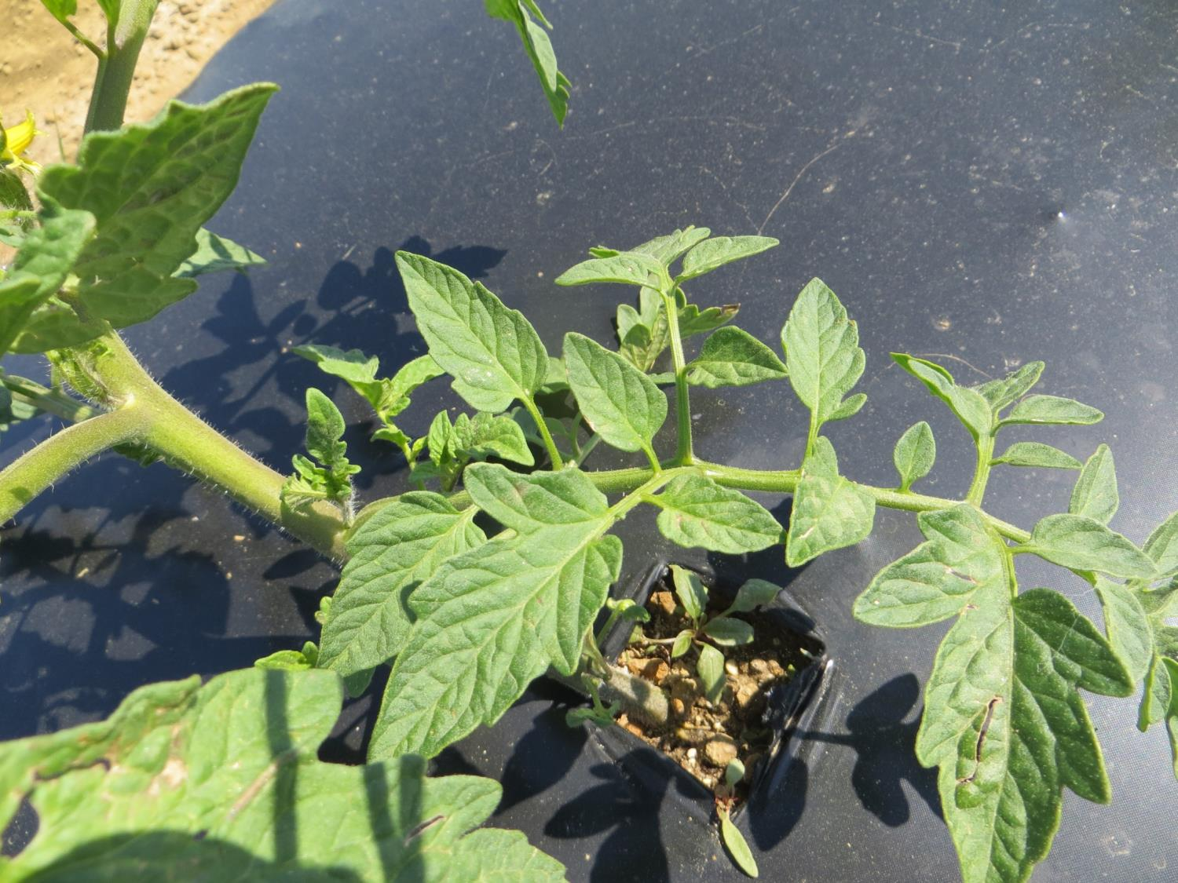
Dual Magnum 8 oz/A

Slide 36
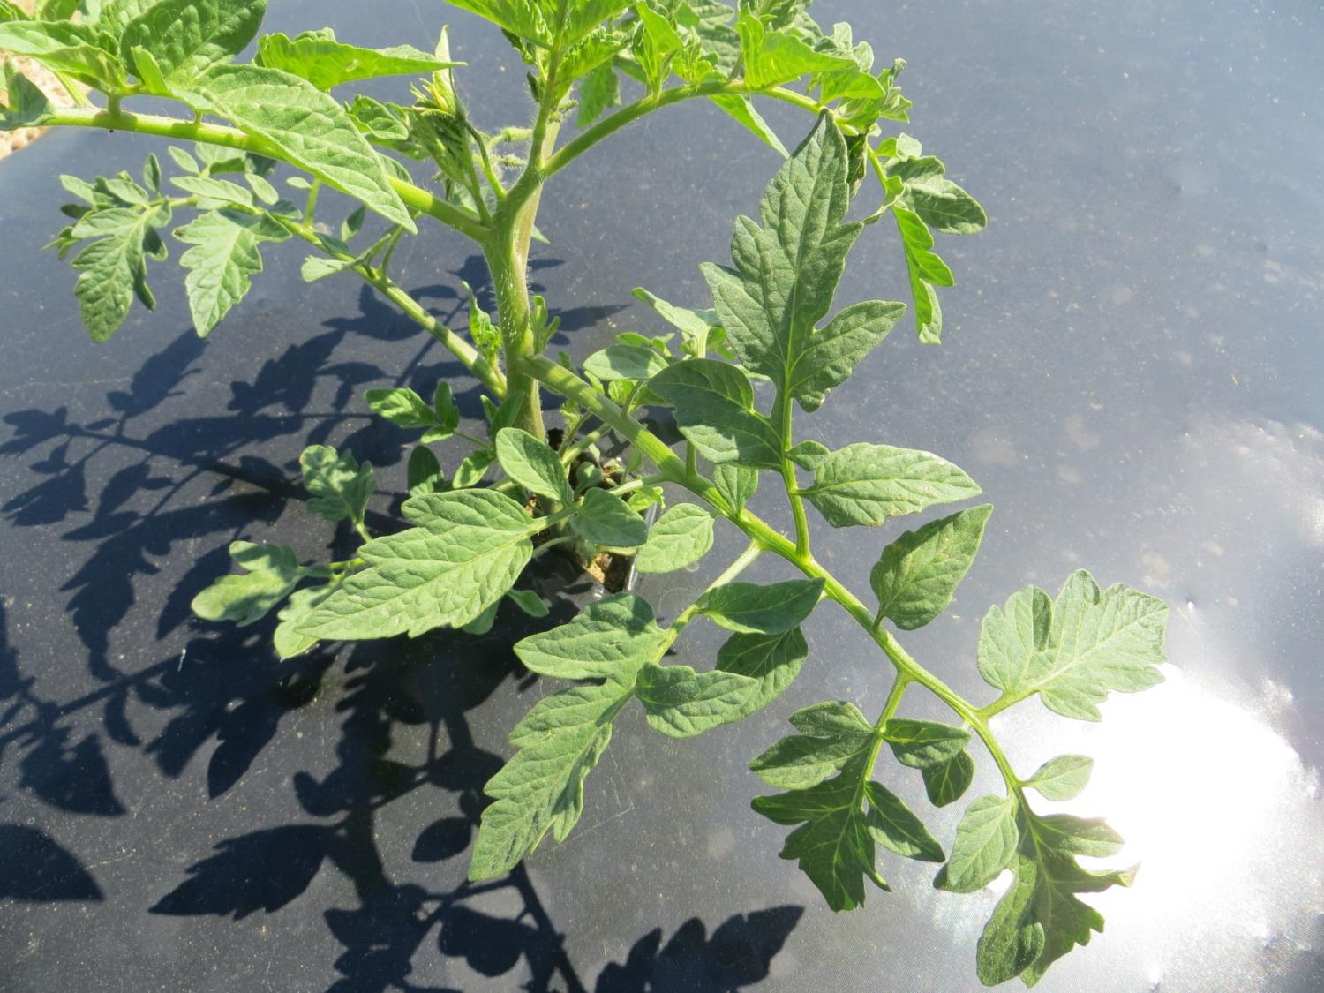
Dual Magnum 12 oz/A

Slide 37
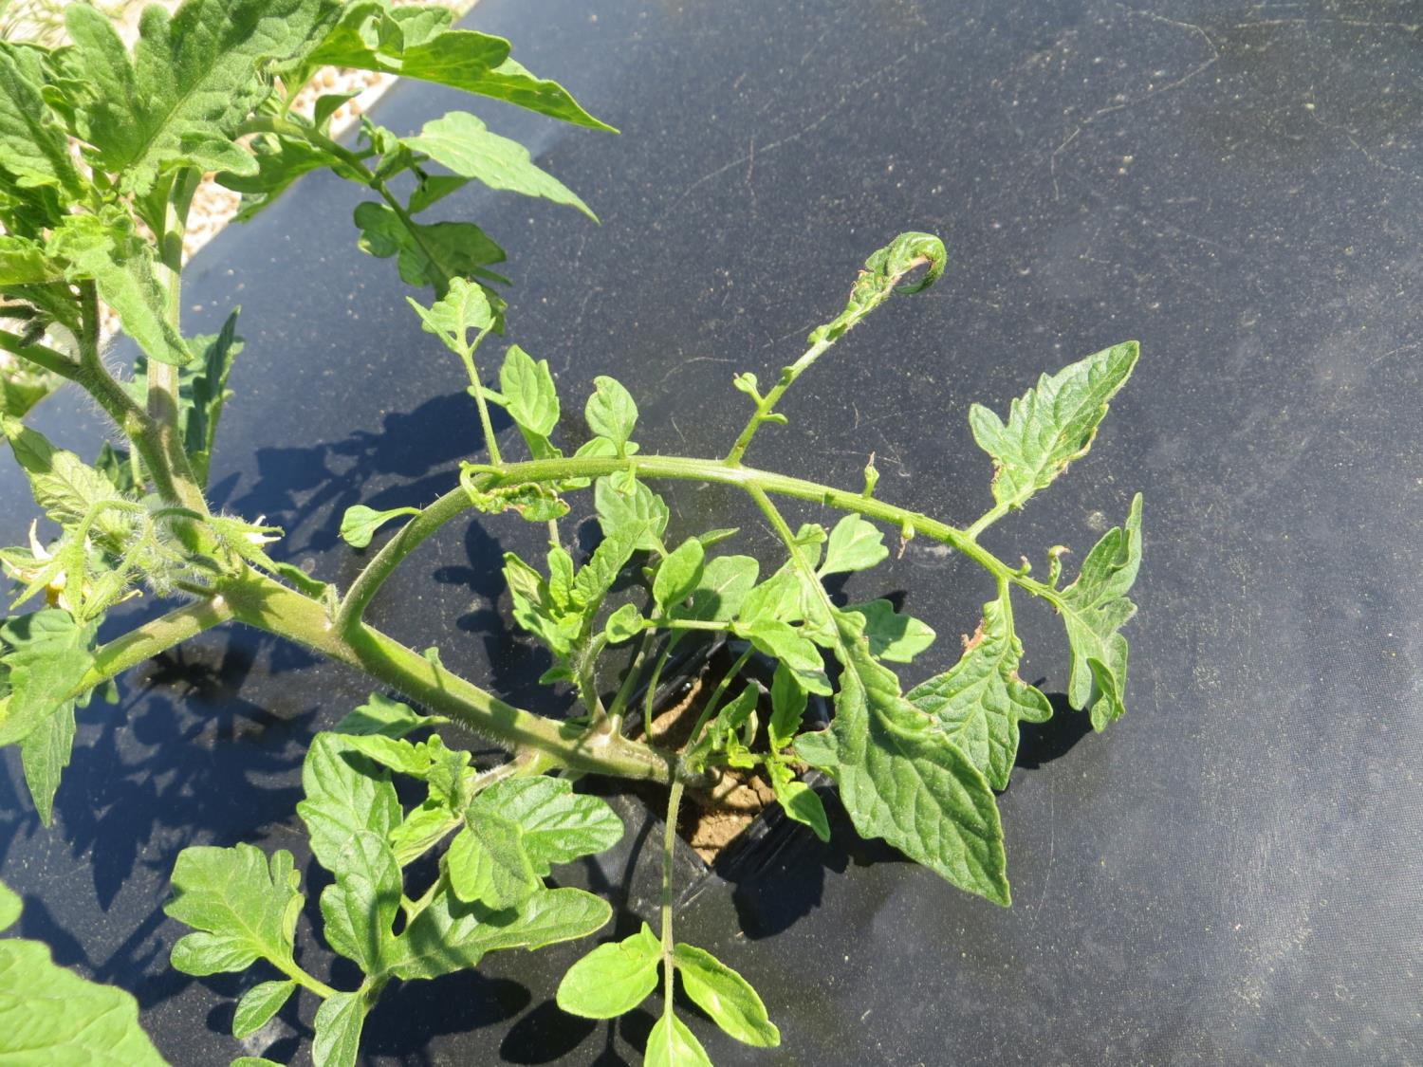
Dual Magnum 16 oz/A

Slide 38
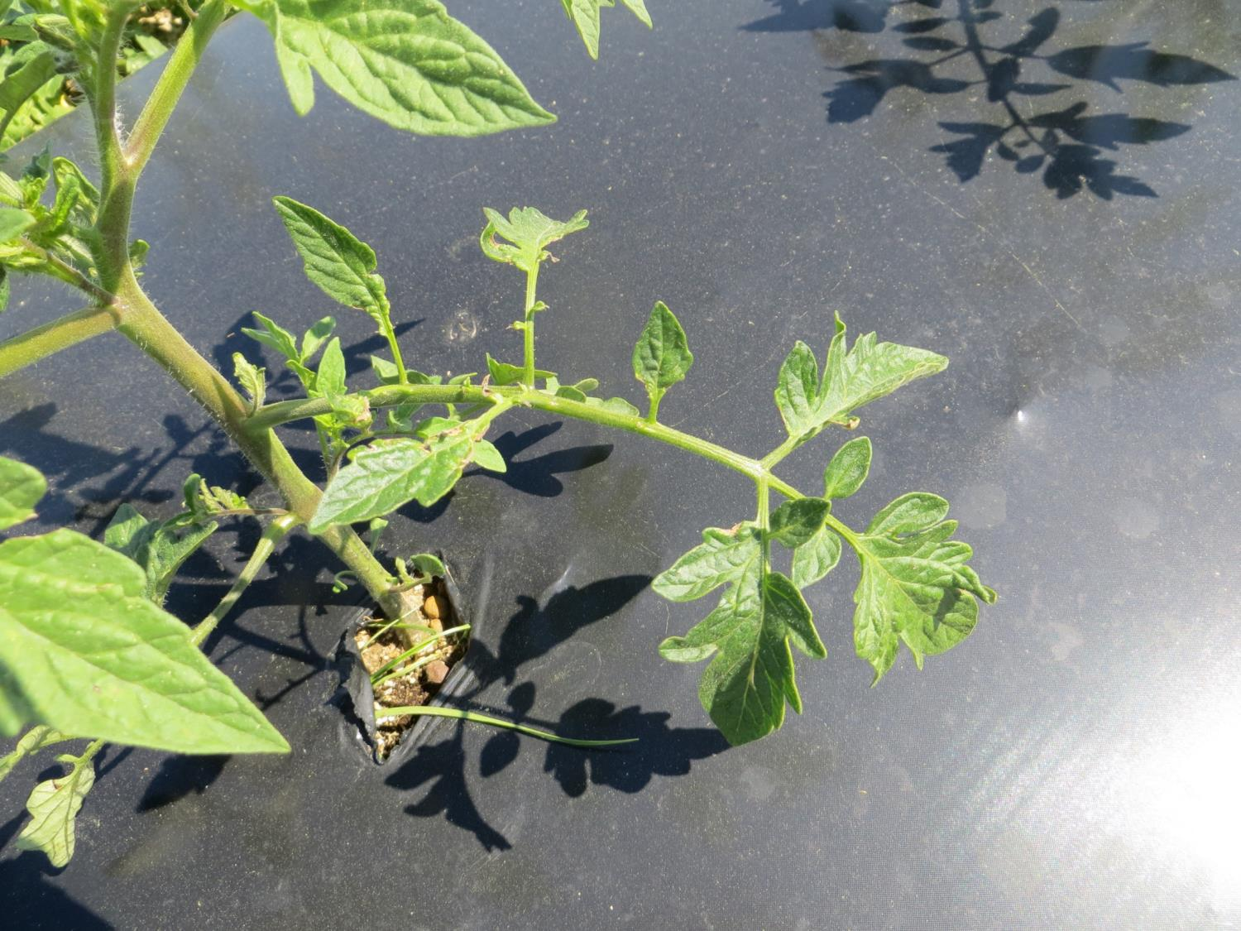
Dual Magnum 24 oz/A

Slide 39
EGGPLANT HERBICIDE PROGRAM
Preplant under mulch
No POST broadleaf option
Topical as needed
Select Max
TapOut
Devrinol

Slide 40
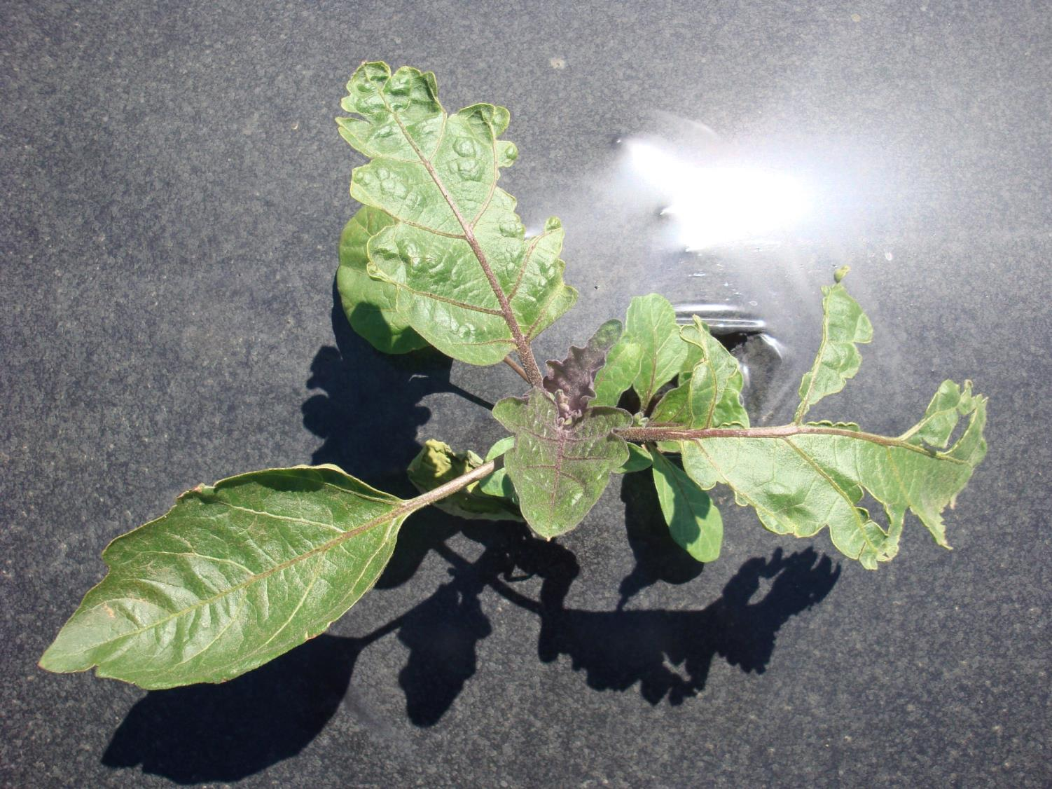
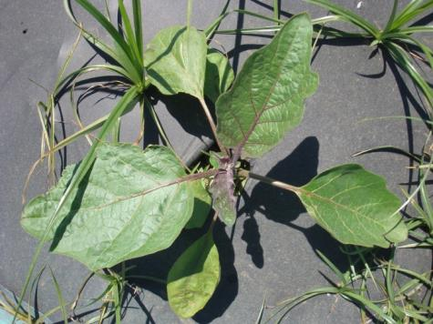
Control
Dual Magnum

Slide 41
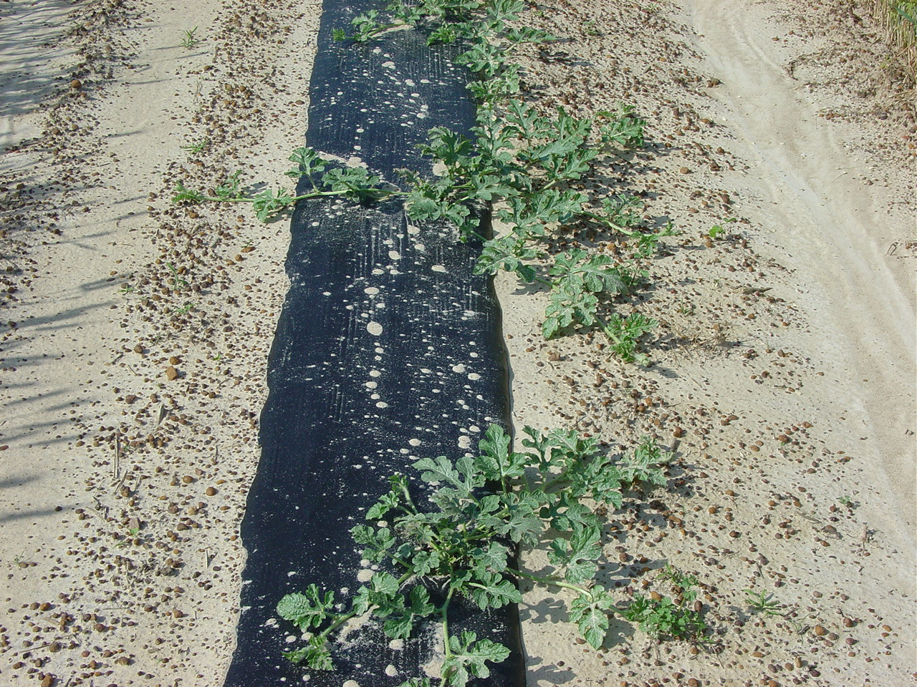

Slide 42
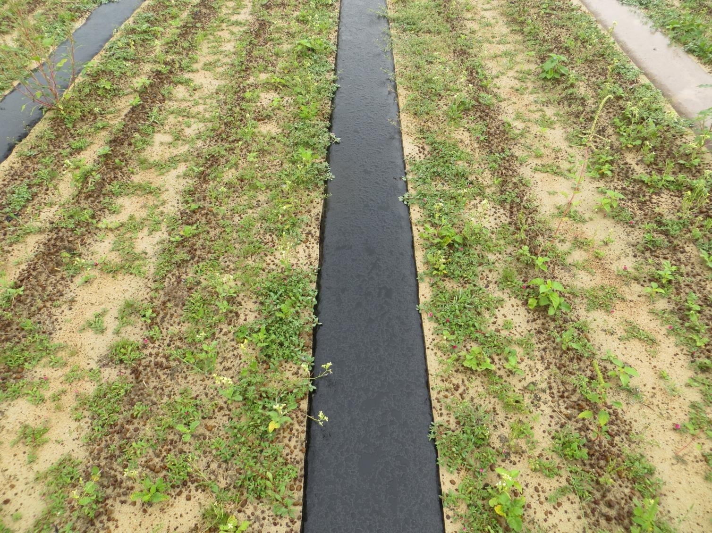
Sinbar + Reflex + Yellow + Roundup or Gramoxone
Under mulch?
Reflex/Sinbar/Sandea?
Metam sodium/Pic

Slide 43
Sinbar + Reflex + Yellow + Roundup or Gramoxone
Under mulch?
Reflex/Sinbar/Sandea--
Metam sodium/Pic

Slide 44
Other Thoughts
Sinbar: great tool except intercropping
Sandea: 7 d preplant, RM
Yellow: great tool, not under mulch
Select Max: least injurious
Rotational: Staple, Envoke, Cadre, Strongarm are often problematic

Slide 45
2015 New Labels-Dual Magnum
Watermelon and Cantaloupe
- Row middle bareground: 8 to 12 oz/A
- Row middle mulch: 12 to 16 oz/A
- Do not apply topically
- Do not broadcast over mulch

Slide 46
Mulched watermelon injury to Dual Magnum applied post-transplant on mulch. TyTy, 2010.
%
50 a
40 b
8 d
16 c
8 oz
12 oz
24 oz
36 oz

Slide 47
Cantaloupe – Preplant/At Plant
Command: watch carryover
Curbit: don’t put under plastic
Metam: under mulch??
Sandea: 7 day preplant

Slide 48
Cantaloupe – Preplant/At Plant
Sandea: POST for nutsedge
Select Max: Grasses 3” or smaller
Treflan: row middle

Slide 49
Cantaloupe – Preplant/At Plant
Sandea: POST for nutsedge
Select Max: Grasses 3” or smaller
Treflan: row middle
NEED NEW TOOLS!!!!!

Slide 50
Squash – Last 2 years game change
Interestingly seeded squash will likely give you the best control options.
Curbit + Reflex PRE
Dual Magnum POST ONCE LABELED

Slide 51
REFLEX - SQUASH
Bareground seed: 8 oz/A PRE + yellow
Bareground transplants:
A. Prepare land;
B. Apply 8 oz Reflex
C. Irrigate
D. Punch hole and transplant

Slide 52
Summer Squash (Yellow & Zucchini)
Dual Magnum
Bareground seed: 8-12 oz POST after 3”
Bareground transplants: 8-12 oz 10-14 DAT
Mulch seed: 8-12 oz POST after 3”
Mulch transplants: 8-12 oz 7-10 DAT.

Slide 53
Dual Magnum and Reflex Indemnified Labels
www.farmassist.com
Products
Indemnified labels
Login (or create login and password)
Georgia, Dual Magnum or Reflex
Accept Waiver
Print label

Slide 54
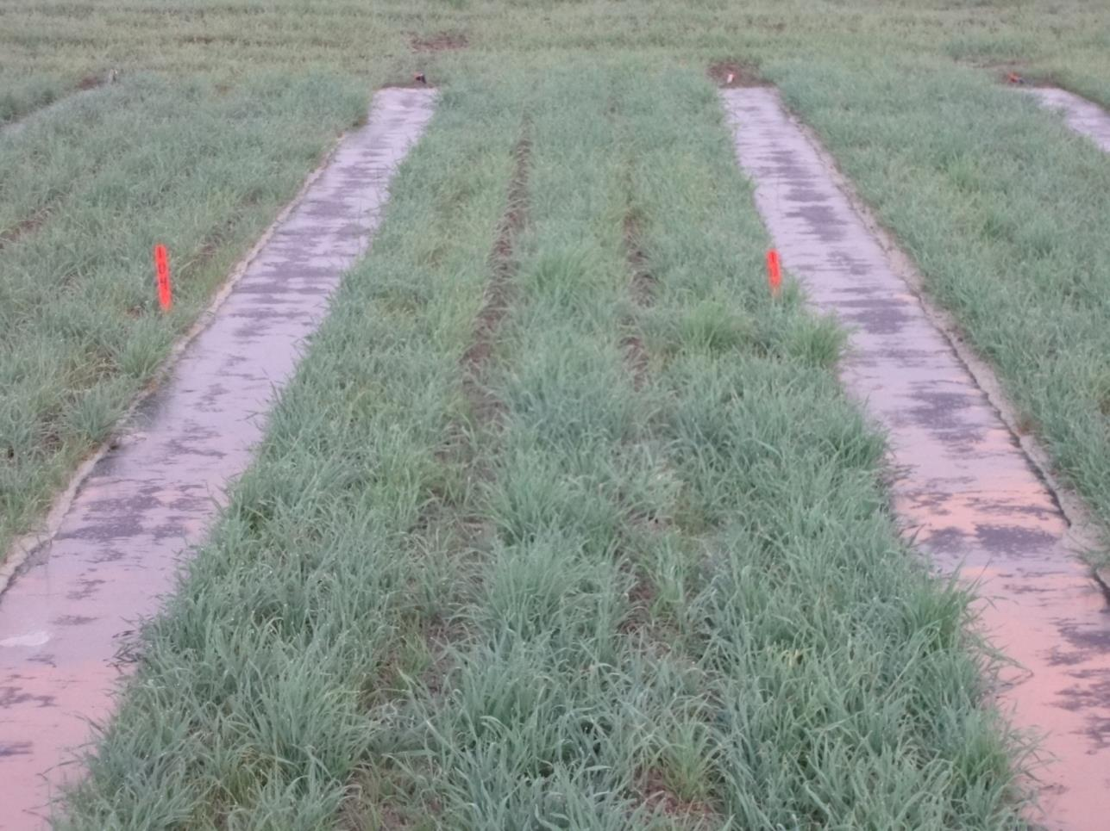
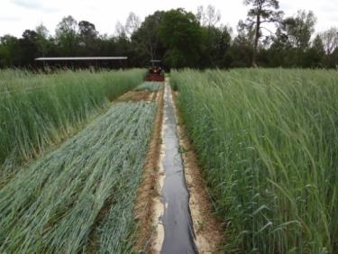
Rye/Mulch System

Slide 55



INDUSTRY
Georgia Department of Agriculture
Commissioner Gary Black

Slide 56
Georgia Vegetable Commodity Commission
Support for most of this work!!!!

Slide 57
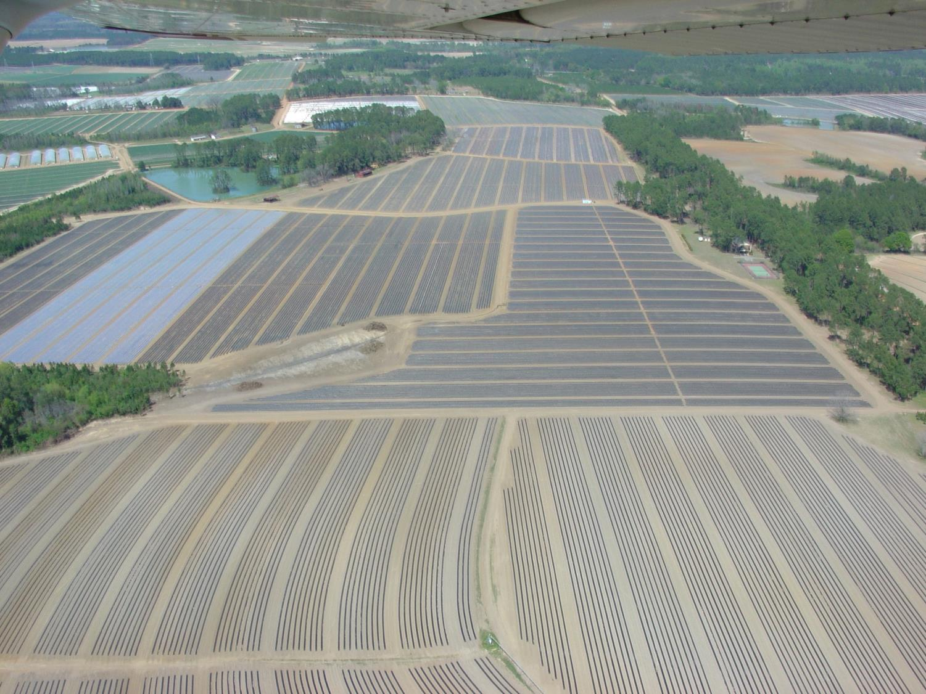
Comments?

